Slide 1
A Dataset of Protected Health Information (PHI)
Leakage in Android Applications
Ashfak Md Shibli
Tahiatul Islam

Slide 2
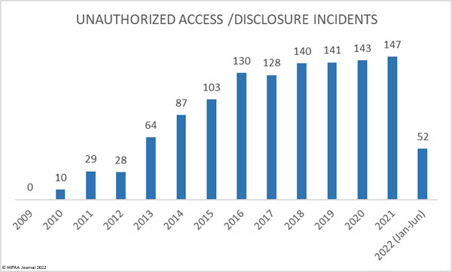
PHI data leakage events
1500 patient data leaked from ZomoHealth
42% of all data breaches attributable to the healthcare industry
Source: HIPAA Journal
-http://healthfinancejournal.com/~junland/index.php/johcf/article/view/67

Slide 3
PHI data points
18 PHI points
SSN
Address
DOB
Name
Medical report number
Email
Source: HIPAA

Slide 4
Why PHI data breach is critical?
Lead to stolen personal identity
Face billing & treatment issue
User trust lost
Companies face penalties

Slide 5
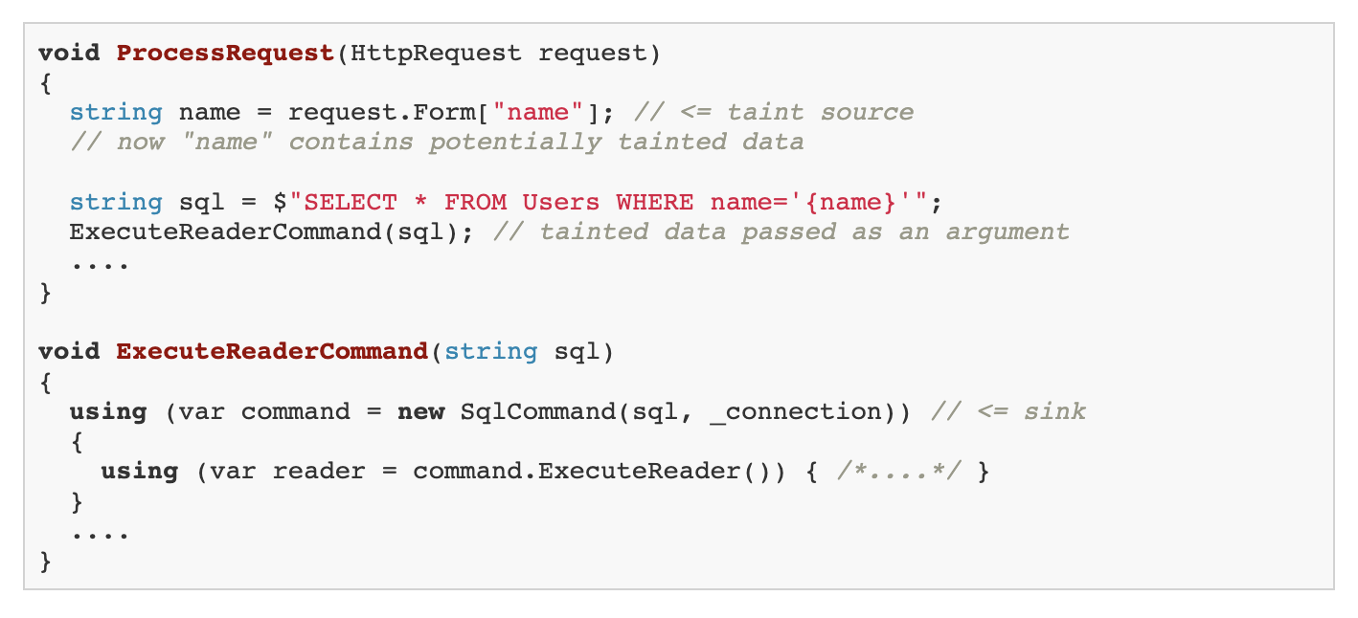
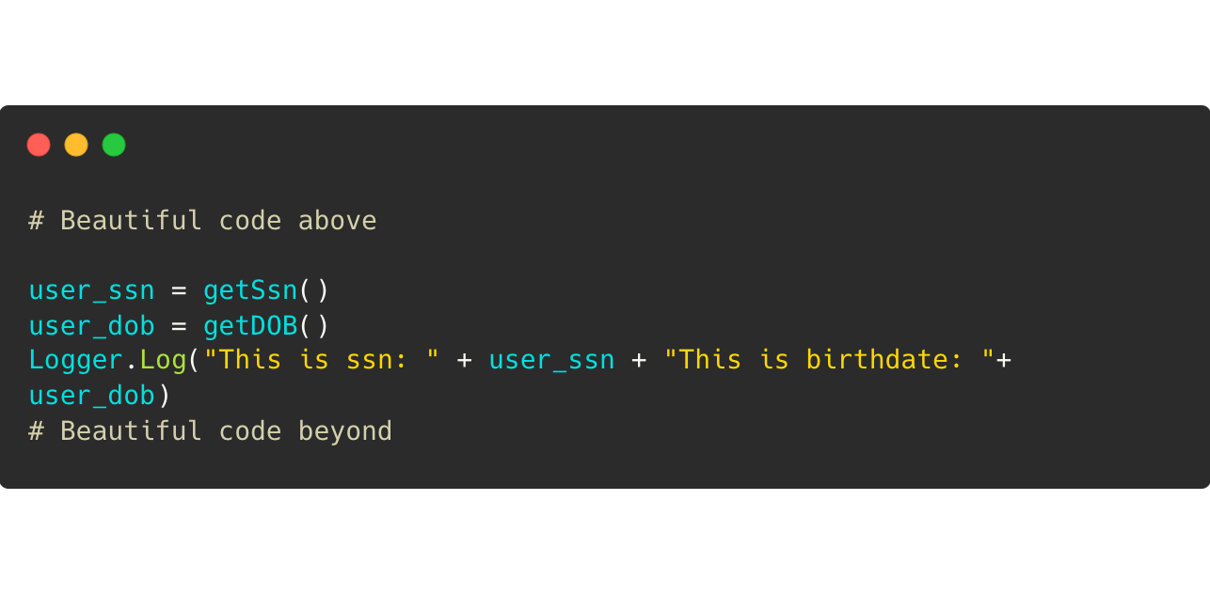
Potential data breaches
SQL Injection
Cross-Site Scripting (XSS)
Insecure webclient connection
Source: https://pvs-studio.com/en/blog/terms/6496/
Logging Secure Data
Phishing attempt to get PHI Data

Slide 6
Our Study
→ Analyze the application leakage
→ Empirically check the False Positives
→ Check the intent of developers
→ Analyze the possible exploit of Attacker
→ Determine relationships of Intents
→ Propose the countermeasure

Slide 7
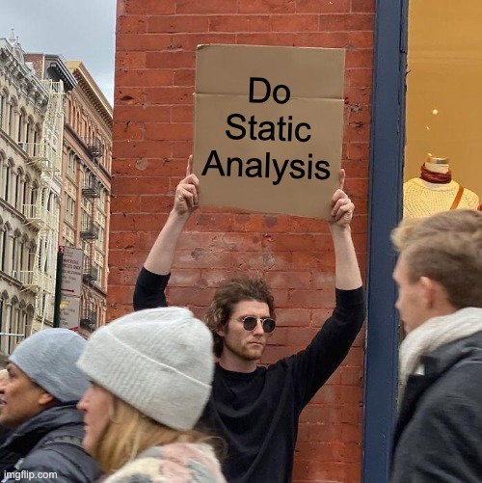
Before you get hit

Slide 8
Static Analysis - Taint - FlowDroid
→ Decompile the APK (Application Package)
→ Analyze the flow from Manifest+XML
→ Build call graph using IFDS inter-procedural, finite, distributive, subset
→ Taint analysis from Source to Sinks
→ Out of the box tool FlowDroid

Slide 9
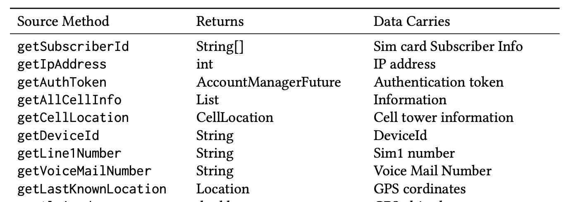
Leakage sources in Android

Slide 10
Sinks in Android

Slide 11
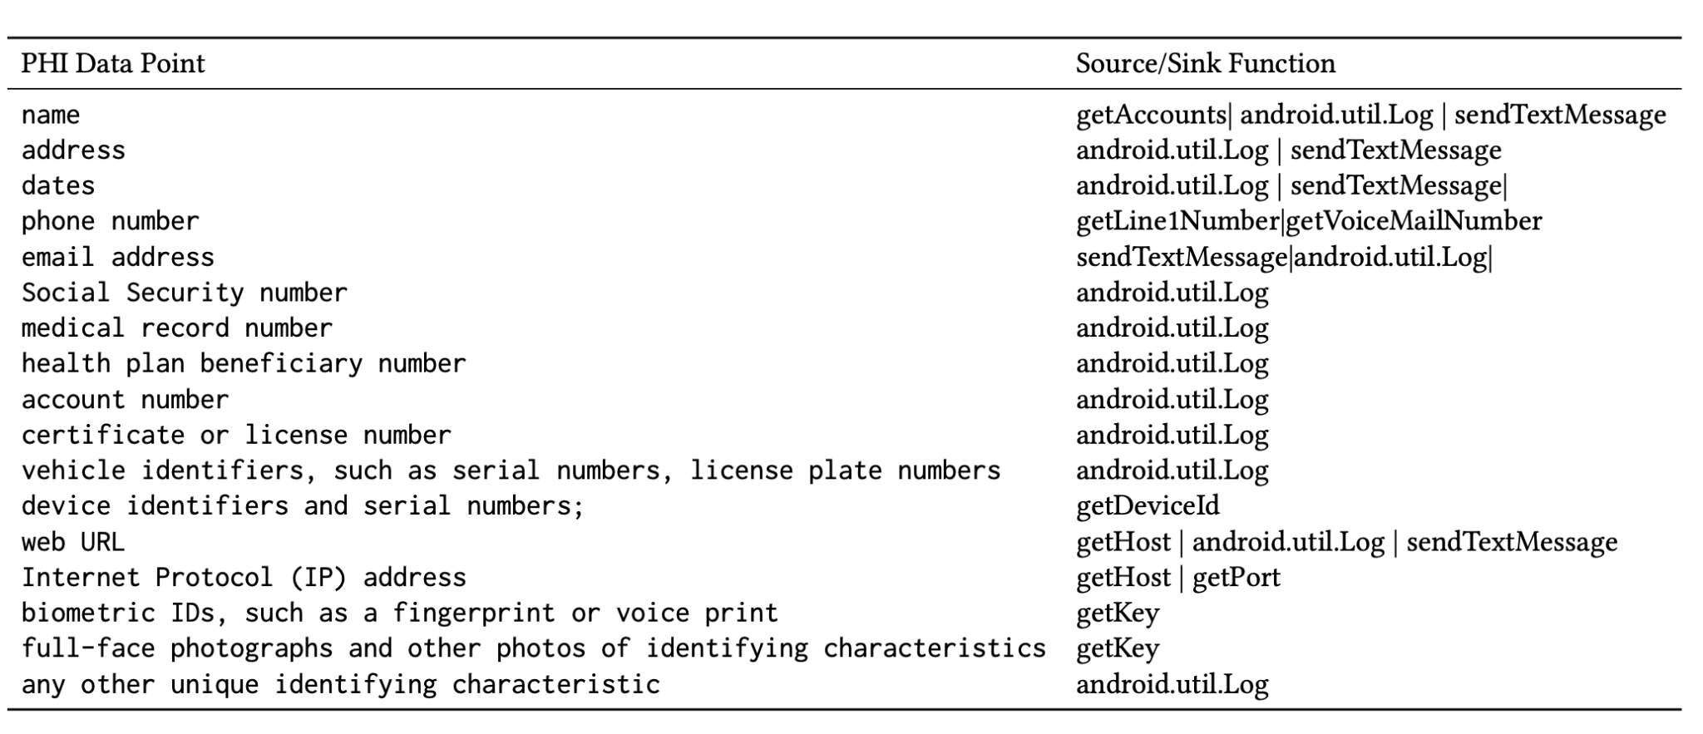
We Mapped PHI → Source/Sinks

Slide 12
Outcome of our study
A dataset having 50 apps
Analyze every app using FlowDroid on
Store leakage and processed flow in dataset
Determine relationship with leaks
Formalize developer intent & attacker exploit
Tabular representation as organized dataset

Slide 13
Developer Intent | Attacker Exploit
It just works that way. | No attack possible. Platform protects.
It was a mistake. | Attacker can get access and keep data to find backdoor to threat and try any gain.
Don’t know it has vulnerability.
Missed to protect the module with best practice. | Hit to exploit or make more secure [from research or testing]

Slide 14
Example
“Universal Remote Control” - 10M Downloads
News says it has leakage
We found leakage in location data
Wait what? Why it is leaking that data?
May be a mistake/disguised malware Developer Intent
Attacker can misuse user location Attacker Exploit

Slide 15
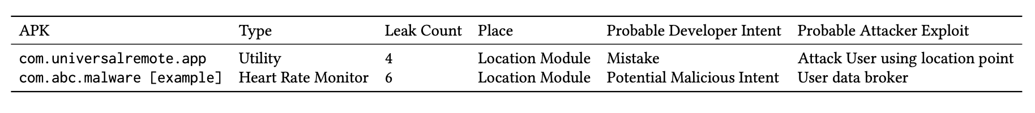
Final Dataset
→ Dataset with application insights and patterns
→ Empirically defined intent specifications
→ Data for future research as there is scarcity of organized data for research on this topic.
→ Data will help users and regulatory bodies.

